Slide 1



Design and Simulation of a Digital Access Card Verification System
Digital Logic Design & Hardware Simulation Presentation
2620030622
GADDAM YASWANTH RATHAN
2620030634
RAJANNAGARI VARUN REDDY
KATTULA NAGA VEERA VENKATA SAI MANIKANTA
GOLI MITHRA REDDY
2620030641
2620030646

Slide 2

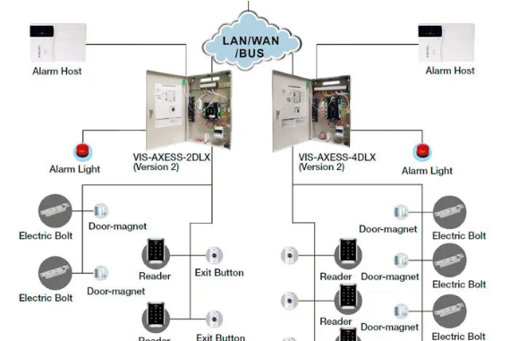
Abstract
Project Goal: Build a secure hardware-based access verification system using pure digital logic and sequential state machines.
Core Mechanism: Instantly compares card credentials and PIN inputs with secure register values.
Simulation Suite: Fully simulated and verified using Logisim for real-time propagation testing.
Reliability: Integrates multi-factor authentication, automatic lockout counters, and visual LED feedback.

Slide 3






Problem Definition
Security Risks
System Latency
Robust Logic Need
Conventional physical keys and basic entry methods lack modern cryptographic logs, secure validation states, and brute-force protection.
Microcontroller or OS-based access terminals suffer from boot delays, kernel overhead, and processing bottlenecks during heavy traffic hours.
Necessity for a high-speed, fault-tolerant hardware pipeline capable of handling parallel ID lookups, retry penalties, and instant alarm triggers.

Slide 4
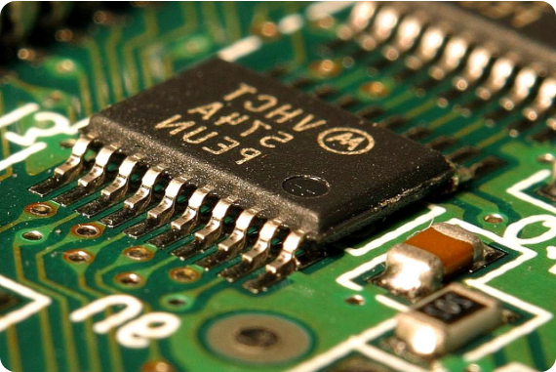
Design and Methodology
Input Stage: Multiplexed switches and keypad inputs mapping card identification bits.
Comparator Array: Bitwise XNOR and AND gate networks evaluating user inputs against master registers.
Control FSM: Finite State Machine managing idle, access granted, and lockout penalties.
Actuation Output: Solenoid driver triggers paired with green/red verification LEDs and buzzers.

Slide 5



Logisim Design
Combinational Sub-circuits
Custom 4-bit and 8-bit magnitude comparators designed with primitive logic gates for high-speed verification.
Sequential Registers
D flip-flops and binary adders configured to track incorrect attempts and manage strict lockout cooldown cycles.

Slide 6
Logisim Implementation
Circuit Module | Logisim Component | Operational Role
ID Matcher | XNOR Gates & Bitwise AND | Performs bit-by-bit verification against stored master card code.
Error Counter | Registers & Adder Circuits | Monitors consecutive failed entries to enforce security lockouts.
State Controller | Finite State Machine (FSM) | Controls seamless transitions between Ready, Verified, and Alarm states.
Feedback Indicators | LED Matrix & Hex Displays | Provides instant visual status for authorized access or security alerts.

Slide 7
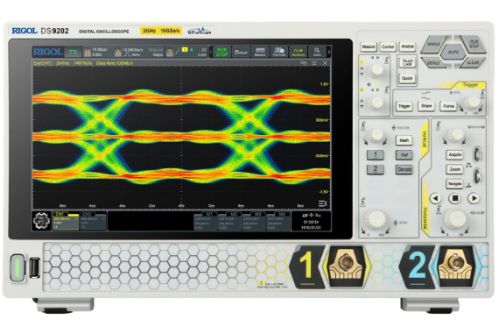
Simulation and Results
Valid Entry Test: Instantaneous HIGH logic signal on Green LED upon correct card ID match.
Invalid Entry Test: Triggers Red LED warning and increments the internal failure register.
Lockout Enforcement: Successfully locks entry after 3 consecutive failures for a preset duration.
Propagation Timing: Total gate propagation delay measured well below safe threshold limits.

Slide 8



Conclusion and Key Takeaways
Hardware Efficiency
Robust Simulation
Future Scope
Proved that secure access control systems can be built efficiently using pure digital hardware logic without microcontroller reliance.
Logisim served as a powerful educational platform for validating complex gate-level connections and state transitions.
Readily scalable to FPGA hardware boards using VHDL/Verilog for real-world deployment and biometric integration.

Slide 9
Thank You
Digital Logic Design & Hardware Simulation Project

